Slide 1


Diabetes
Prediction & Recommendation
July 5, 2022

Slide 2
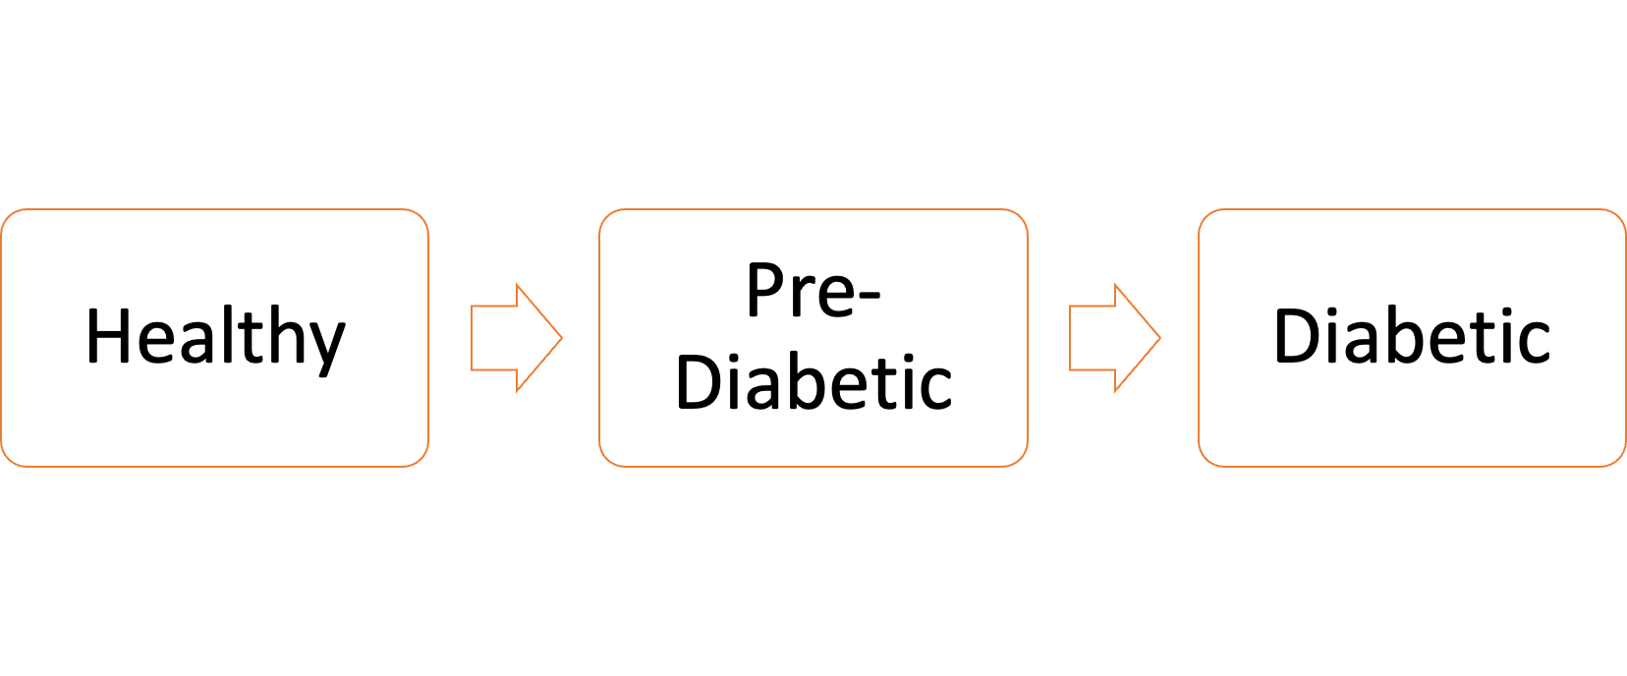
Problem Statement
Type 2 Diabetes Mellitus is among the most prevalent chronic diseases worldwide.
Diabetes is a serious chronic disease in which individuals lose the ability to effectively regulate glucose levels in the blood, which can lead to reduced quality of life and life expectancy.

Slide 3

Aim
Web Application
Prediction & Recommendation model for Type 2 Diabetes Mellitus based on
Behavioral Risk Factors.
Early Diagnosis
Early Intervention
Reduce Medical Costs

Slide 4

Targets

Slide 5
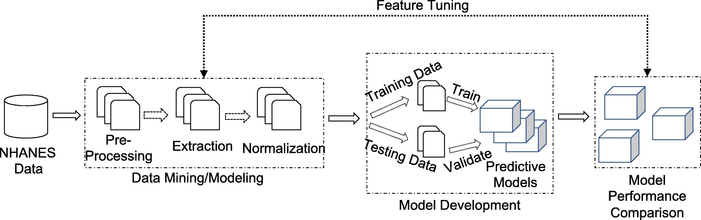
Data Flow

Slide 6
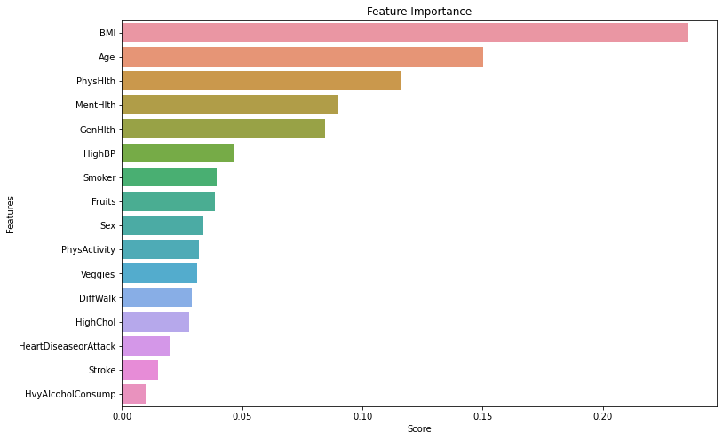
Feature Importance

Slide 7
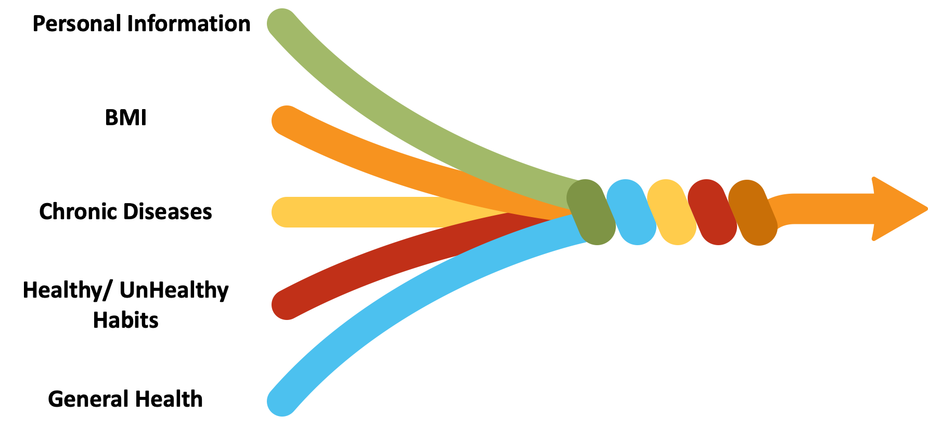
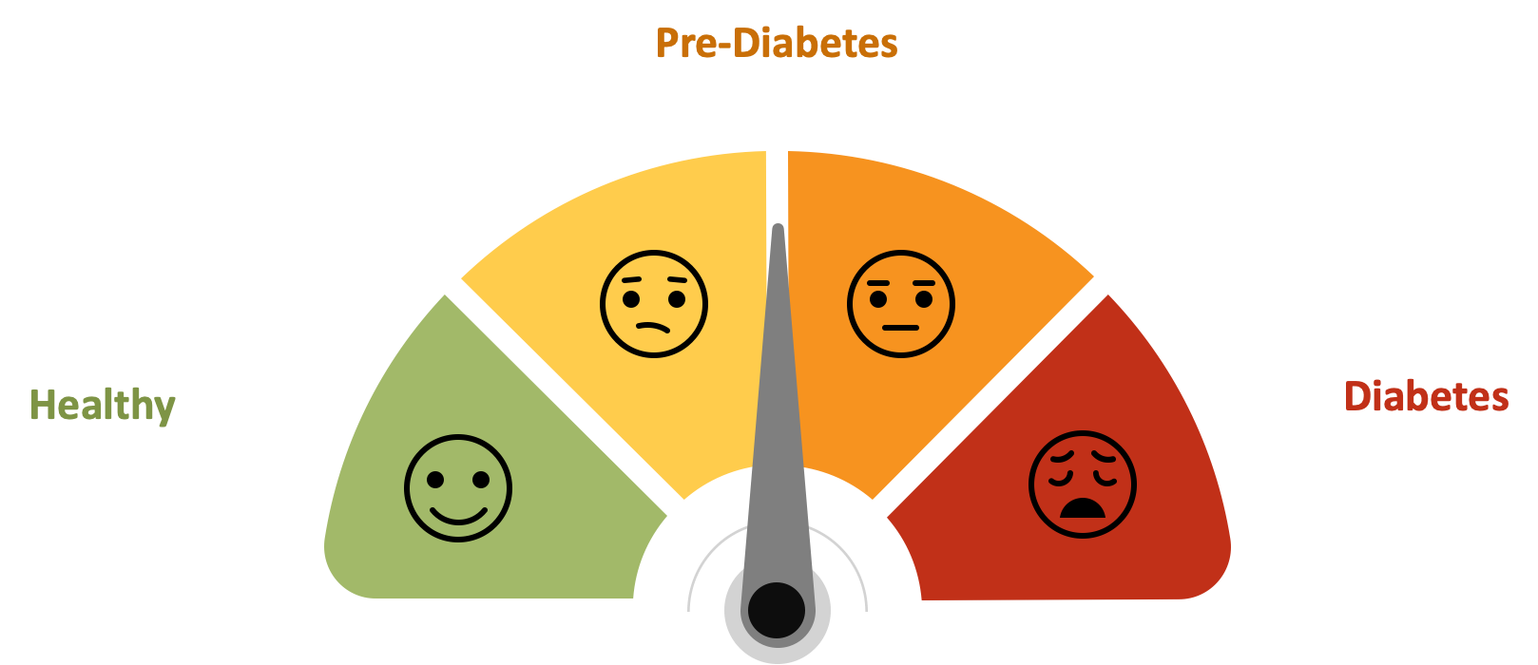
Model Development
Pearsonalized Report
Recommendation/s
One-on-One Coaching

Slide 8
Machine Learning Model

Slide 9
Thank You

